Slide 1
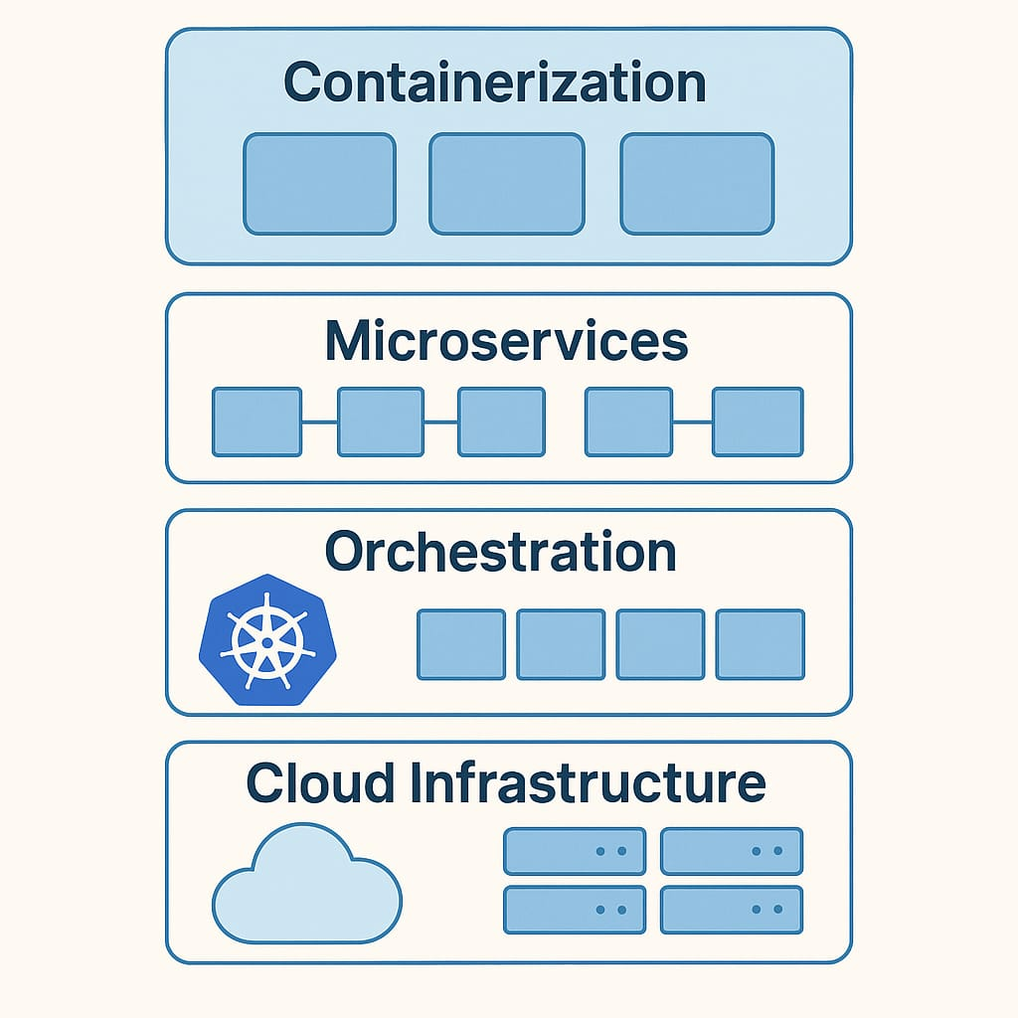
CSA1510 | Cloud Computing and Big Data Analytics
Containerization &
Cloud-Native Applications
PRESENTED BY
Usha Nandhini P[192511263]

Slide 2
What is Containerization?
A container packages an application together with everything it needs to run—code, libraries, and settings—into one lightweight unit.
Containers share the host machine’s operating system kernel, unlike virtual machines which each need a full OS.
This makes containers fast to start, small in size, and easy to move between laptops, servers, and the cloud.
Popular tools: Docker (to build/run containers) and Kubernetes (to manage many containers).
App
Libraries
Config
One Container
2

Slide 3
Container Architecture
How containers sit on top of a single host operating system
App A
App B
App C
Container Engine (e.g., Docker)
Host Operating System
Physical / Cloud Infrastructure
3

Slide 4
Virtual Machines vs. Containers
Virtual Machine
Container
App
Guest OS
App
Hypervisor
Container Engine
Host OS
Host OS
Hardware
Hardware
4

Slide 5
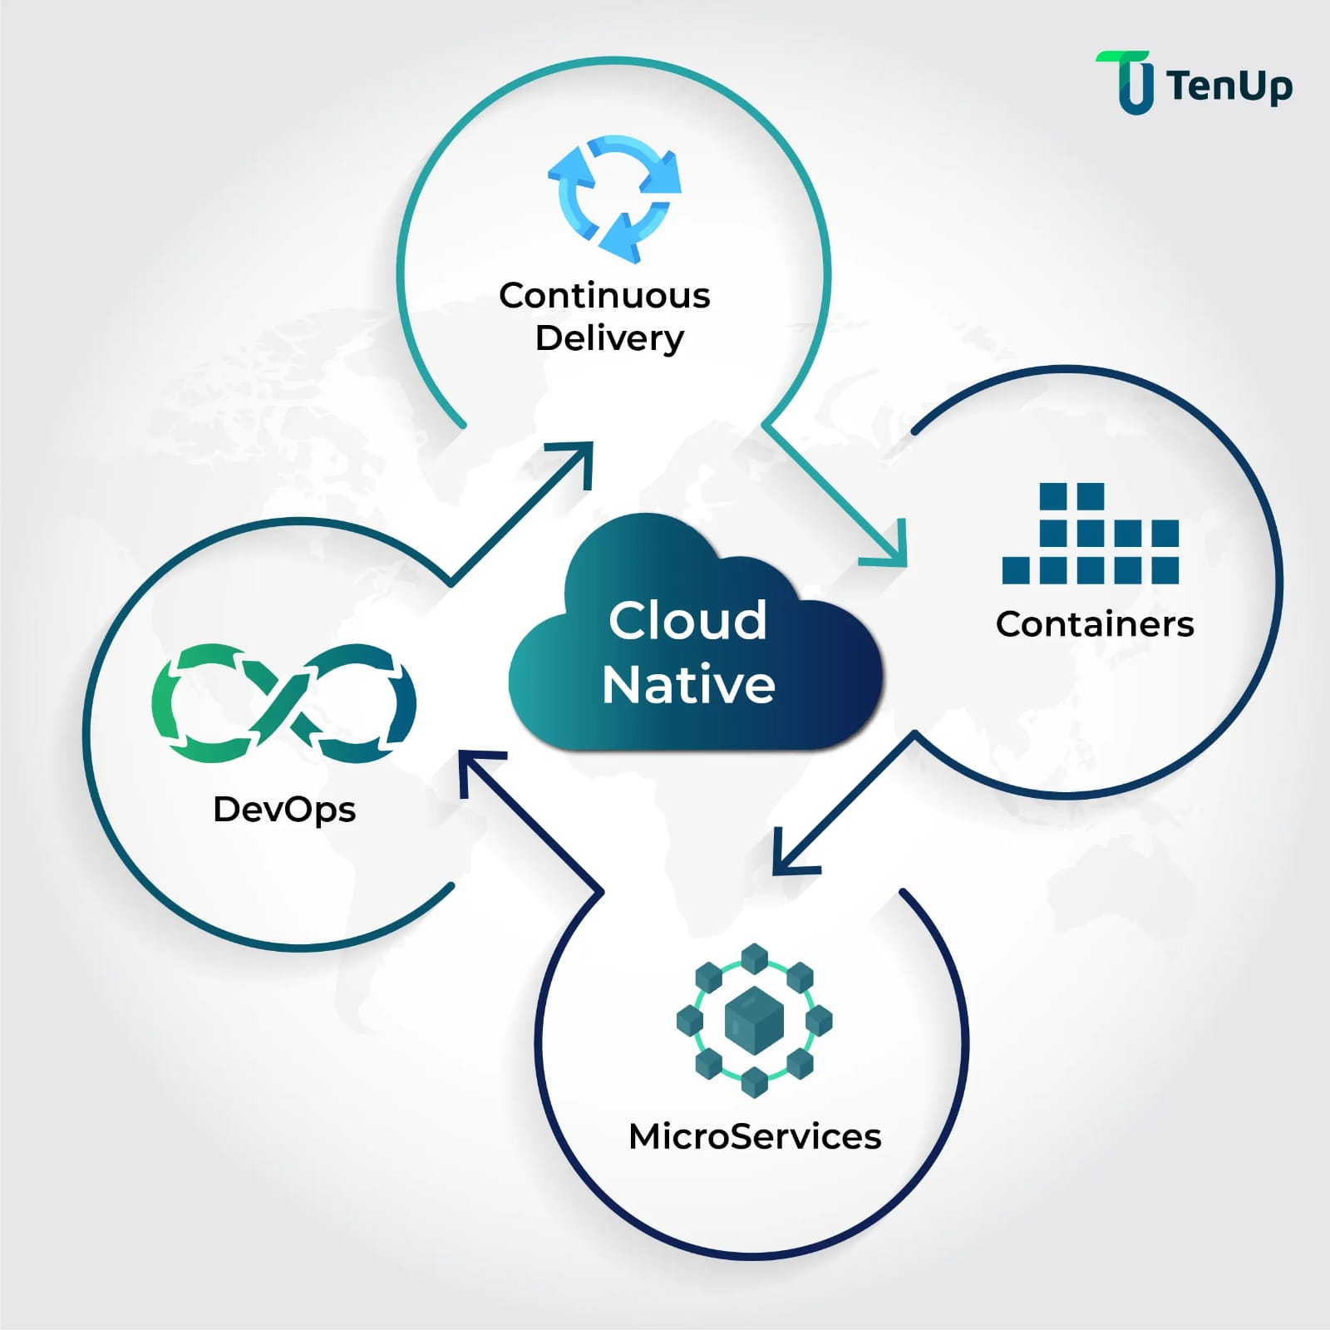
Industry Relevance
Faster Deployment
1
Teams ship new features in minutes instead of days, since containers start almost instantly.
Cloud Portability
A container built on a laptop runs the same way on AWS, Azure, or Google Cloud.
Scalability
3
4
Platforms like Kubernetes automatically add or remove containers as user demand changes.
Cost Efficiency
Multiple containers run on one server, using hardware resources far more efficiently than VMs.
5

Slide 6
Real-World Use Case
Netflix streaming platform
Netflix runs thousands of microservices (recommendations, billing, streaming) inside containers, managed with tools built on top of container technology.
Each microservice is packaged as its own container, so teams can update one service without affecting the rest of the platform.
Containers let Netflix automatically scale up during peak viewing hours (e.g., a new show launch) and scale down afterward.
Result: faster releases, higher reliability, and efficient use of cloud resources for millions of viewers worldwide.
Auto-scaling with demand
Containerization & Cloud-Native Applications
6

Slide 7
Conclusion & Key Takeaway
Containerization packages applications with everything they need, making software easier to build, ship, and run consistently.
Compared to virtual machines, containers are lighter, faster, and more efficient because they share the host OS kernel.
Tools like Docker and Kubernetes have made containers the standard for cloud-native applications across the industry.
Key Takeaway: Containers let organizations deploy software faster, scale it efficiently, and run it reliably anywhere in the cloud.
Thank You

Slide 8
Thank You!!

